Slide 1
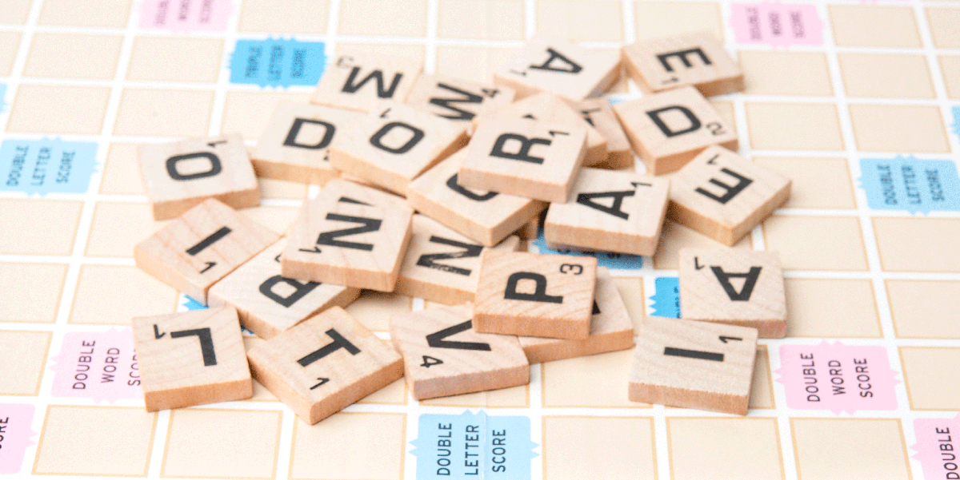

Programming for Problem solving G - LOB
By
Abbas Hussain , 23231A0501
Suryadevara Aditya , 23241A0554
Govind Jadhav , 23241A0525
Shiva Ruthvik Reddy , 23241A0538

Slide 2
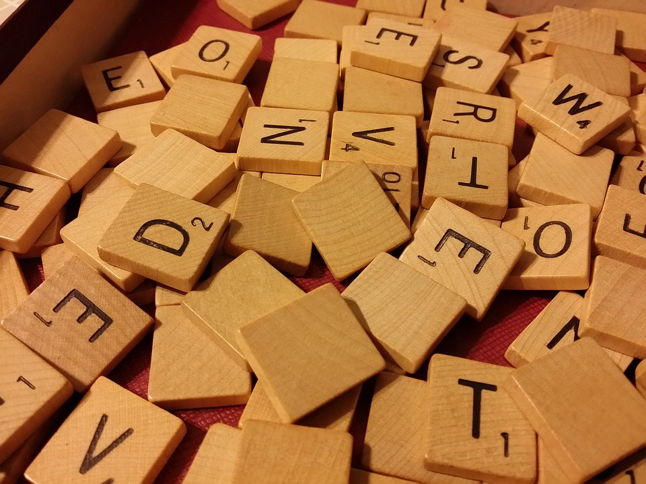
UNDERSTANDING
THE SCRAMBLE WORD GAME
An analysis of the C program and its components

Slide 3
Functionalities used in The Scramble game
Functions
Iteration (Loops)
Conditional Branching Statements
Srand() and rand() Function
String Manipulation Functions
Standard Functions(printf and scanf)
Time Function
Standard Libraries

Slide 4
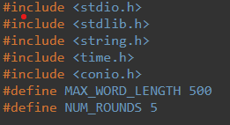
Header Files
These are the standard C libraries used in the program --
stdio.h for input/output
stdlib.h for memory allocation
string.h for string manipulation
time.h for generating random numbers and
conio.h for using the getch() function to get input without echoing to the console.

Slide 5

Constants Declaration
A macro named MAX_WORD_LENGTH with a value of 500 is defined. Here, MAX_WORD_LENGTH is used to represent the maximum length of a word in the program.
A macro named NUM_ROUNDS with a value of 5 is defined. Similarly, this macro is used to represent the number of rounds in the game

Slide 6
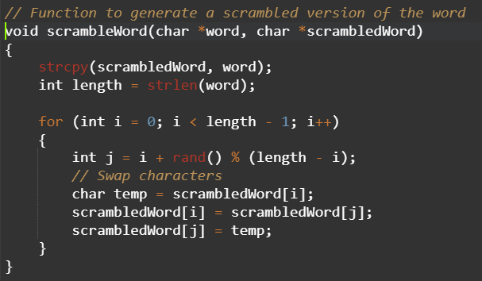
Function : scrambleWord
The scrambleWord function takes an input word, copies it to another string (scrambledWord), and then shuffles the characters within scrambledWord to create a scrambled version of the original word.
strcpy function is used to copy the characters from the original word to the scrambled word. This ensures that the initial state of scrambledWord is the same as word.
The for loop is used to iterate through each character of the word, excluding the last character as the last character in the word doesn't need to be swapped with any character.
The rand() function is used within the loop and is used to generate a pseudo-random integer.
We used a common technique known as Knuth shuffle. It involves swapping the current character at index i with a randomly selected character at index j. This process is repeated for each character in the word, effectively shuffling the characters.

Slide 7
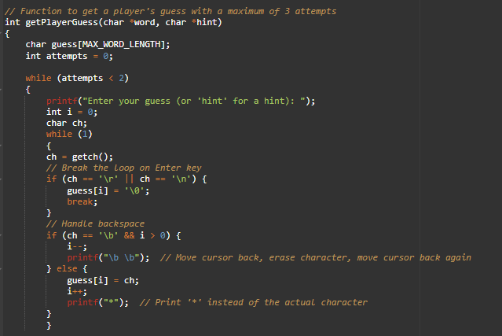
Function : getPlayerGuess
This function handles a player's guess for a given round. It allows the player to enter a guess, providing hints if the player types "hint." It also handles backspace to correct mistakes. The function returns the score for the round based on the correctness of the guess and the number of attempts.
First we declares an array to store the player's guess. This array is used to store the characters entered by the player when guessing the word.
An variable named “attempts” of data type int is declared and is initialized to value 0. This is to keeps track of the number of attempts the player has made.
Now, another while loop is initialized to handle user input for the guess. It reads characters, handles backspace, and prints '*' instead of the actual character to hide the input given by players.

Slide 8
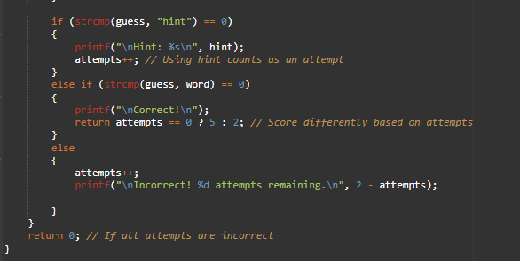
Now we use the string functions strcmp() to check if the player entered "hint”. If the player's guess is equal to "hint“, the program prints a hint and increments the attempts variable.
Again the string compare function is used to compare the player’s guess with the actual word. If they are equal,the program prints a correct message and returns a score based on the number of attempts.
In the end ,the variable attempts is incremented if the player’s guess is incorrect.

Slide 9
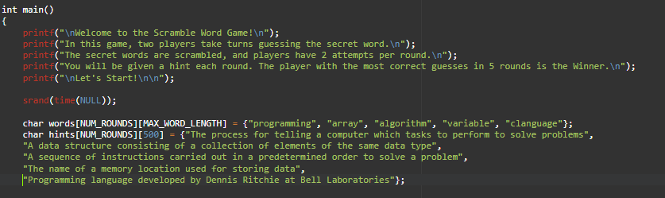
Main Function
The main function orchestrates the entire Scramble Word Game, handling initialization, game rounds, player input, scoring, and determining the winner. It provides a user-friendly experience with informative messages at each step.
As shown, srand() , Seed Random Number Generator is used to with the current time, ensuring a different sequence of random numbers on each run of the program.
Next we declare 2 variables words and hints (char) to store the secret word and the corresponding hint for each round.
This part of the code sets the stage for the Scramble Word Game, providing introductory messages, seeding the random number generator, and initializing arrays with secret words and hints.

Slide 10
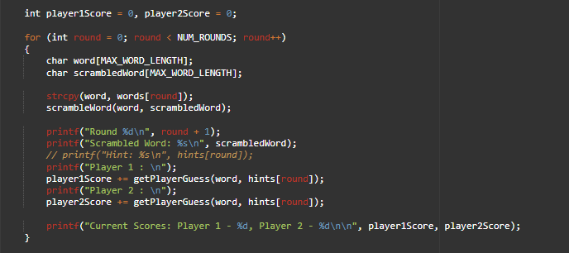
Main : Game Loop & printing information
This block of code represents the core game loop where each round involves getting a secret word, scrambling it, prompting players for guesses, updating scores, and displaying round information. The loop repeats for the specified number of rounds (5 in this case).
First we initialize int variables player1Score and player2Score to 0 before the start of the game.
Round Setup - We declare a character array "word" to store the current secret word and declare a character array "scrambleWord" to store the scrambled version of the secret word.
We use string copy to get the secret word from the word array to variable and then function “scrambleWord” is used to get the scrambled version of the secret word.
The players give their guesses and the score is simultaneously updated each round.

Slide 11
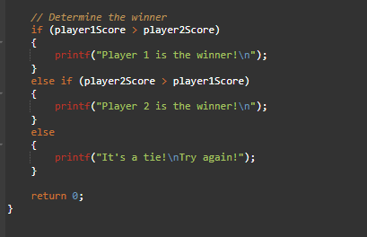
Main : Determining the Winner
This block of code concludes the Scramble Word Game by determining the winner based on the scores of Player 1 and Player 2. The winner is determined by comparing their scores, and the appropriate message is printed to the console.If there is a tie, a message suggesting another attempt is displayed. The return statement at the end indicates the successful completion of the program.
We use the conditional statement if else if to determine the winner of the scramble game.
If player1 score is greater than player2,player 1 wins likewise if player2 score is greater player2 wins.

Slide 12
Conclusion
The program creates a simple word scramble game for two players, providing a user-friendly interface with hidden input and hints. Players take turns guessing words in each round, and the winner is determined based on the total score after all rounds. The game is designed to be educational, using programming-related words and providing hints to help players learn.
The Scramble Word Game code showcases fundamental programming concepts such as string manipulation, randomization, and user input handling. It offers an interactive and educational experience, reinforcing programming-related terms while engaging players in a challenging word game.
In conclusion, the Scramble Word Game demonstrates the versatility of C programming for implementing interactive and educational applications. It encourages learning through gameplay and provides an enjoyable experience for players.

